Slide 1

Programming Languages
Produced
by:
Eamonn de Leastar (edeleastar@wit.ie)
Dr. Siobhán Drohan (sdrohan@wit.ie)
Department of Computing and Mathematics
http://www.wit.ie/

Slide 2
Topic List
Programming Languages:
Family Trees.
Characteristics.
Typing Spectrum.

Slide 3
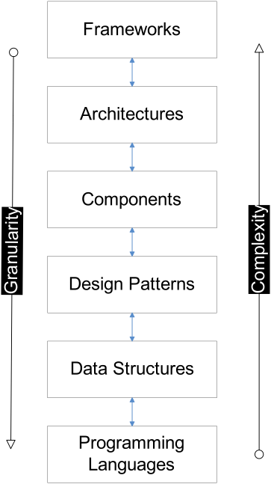
Choice of programming language can have profound effect on accessibly of knowledge at higher layers.

Slide 4
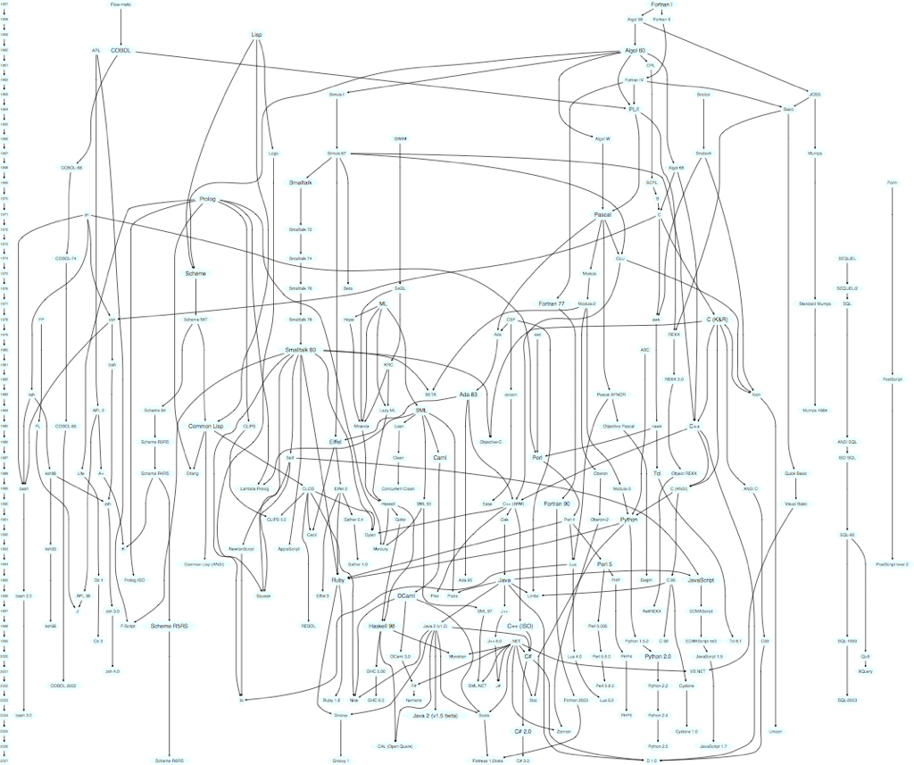
Family Tree

Slide 5
Family Tree
“Lisp is the Chuck Norris of programming languages.”
“Lisp is the bar other languages are measured against.”
“Knowing Lisp demonstrates developer enlightenment.”
Lisp - designed late 1950s - departure from existing languages (e.g. Fortran).
Lisp, Fortran Cluster
https://hase85.wordpress.com/2013/01/15/best-of-lisp-quotes/

Slide 6
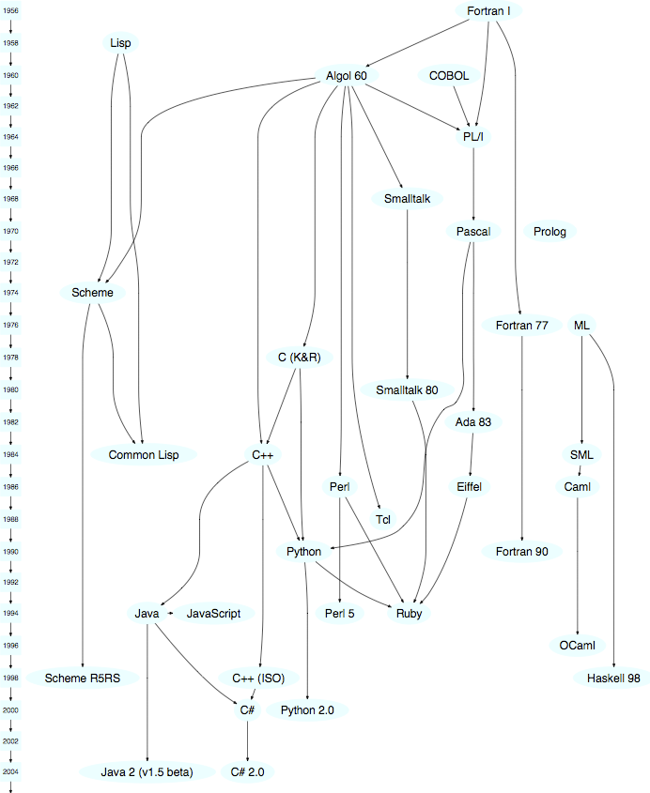
Family Tree
Lisp, Fortran Cluster

Slide 7
Family Tree
Objective C – borrows Smalltalk concepts & syntax.
Java – borrows Smalltalk bytecode and garbage collection.
Smalltalk - pure OO language → everything is an object!
Ruby – pure OO model almost identical to Smalltalk.
Smalltalk Cluster
https://www.cs.cmu.edu/~charlie/courses/15-214/2014-fall/slides/25-history-oo.pdf

Slide 8
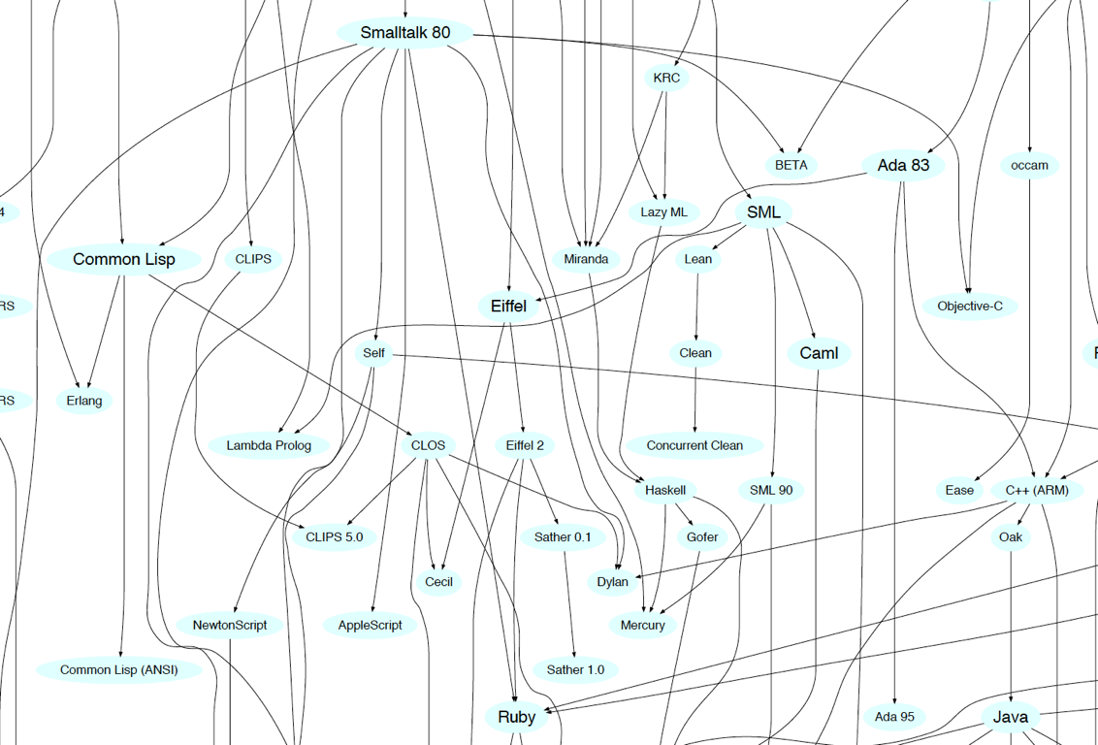
Smalltalk Cluster
Family Tree

Slide 9
Smalltalk
Mainstream OO Languages

Slide 10
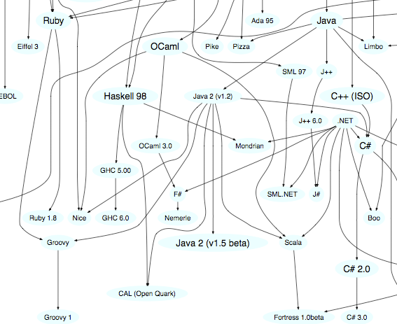
Ruby, Groovy, Java, Scala Cluster
Family Tree

Slide 11
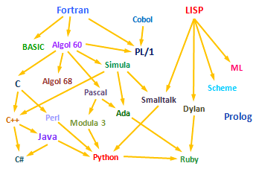
Family Tree
Objective-C
Scala
Groovy
Swift
Kotlin
Go

Slide 12
Why so many programming languages?

Slide 13
Programming Languages as Reactions
“Kevin Kelleher suggested an interesting way to compare programming languages: to describe each in terms of the problem it fixes.
The surprising thing is how many, and how well, languages can be described this way.”
http://www.solipsys.co.uk/new/EveryLanguageFixesSomething.html

Slide 14
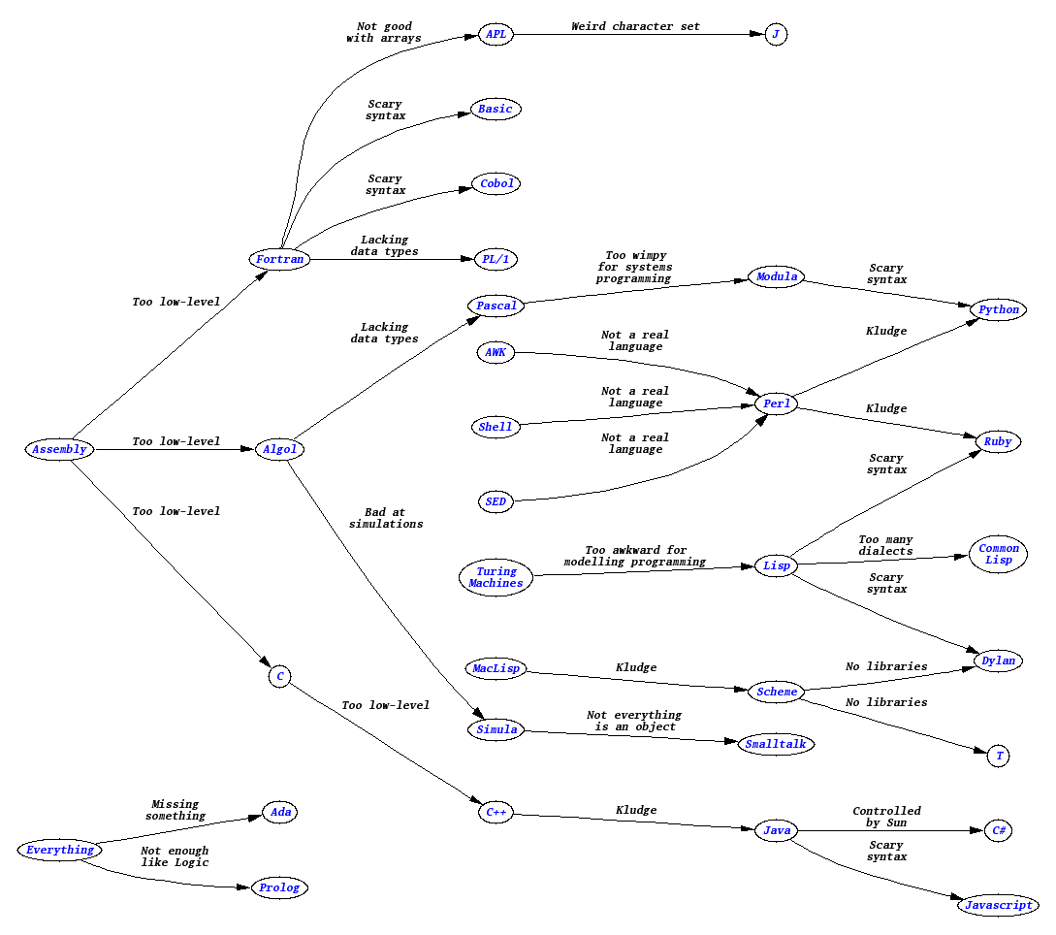
Programming Languages as Reactions
http://www.solipsys.co.uk/new/EveryLanguageFixesSomething.html

Slide 15
http://www.solipsys.co.uk/new/EveryLanguageFixesSomething.html

Slide 17
Paul Graham’s Wish List for a Programming Language
Lisp was designed in late 1950s.
It was a radical departure from existing languages e.g. Fortran.
It embodied nine new ideas, which can be looked upon as a wish list for a programming language.
http://www.paulgraham.com/icad.html

Slide 18
Paul Graham's Wish List for a Programming Language
Wish List | Description / Example
Conditionals | If-the-else constructs are taken for granted now, but Fortran didn’t have them.
A function type | Functions as data type just like integers or strings and can be stored in variables, passed as arguments, etc.
Recursion | The solution to a problem depends on solutions to smaller instances of the same problem i.e. by allowing a function to call itself within the program text.
Dynamic typing | Where values have types, not the variables.
Garbage collection | Automatic memory management by reclaiming memory occupied by objects that are no longer in use.
Programs composed of expressions | As opposed to a series of statements.
A symbol type | Symbols are effectively pointers to strings stored in a hash table. So you can test equality by comparing a pointer, instead of comparing each character.
A notation for code using trees of symbols and constants | e.g. expressing programs directly in parse trees that get built behind the scenes.
The whole language there all the time | i.e. no real distinction between read-time, compile-time and runtime.
http://www.paulgraham.com/icad.html

Slide 19
Java
Wish List
Conditionals
A function type (from Java 8)
Recursion
Dynamic typing
Garbage collection
Programs composed of expressions
A symbol type
A notation for code using trees of symbols and constants
The whole language there all the time
http://www.paulgraham.com/icad.html

Slide 20
Groovy/Ruby/Python/Scala/Xtend/Kotlin (from Neal Ford)
Wish List
Conditionals
A function type
Recursion
Dynamic typing
Garbage collection
Programs composed of expressions
A symbol type
A notation for code using trees of symbols and constants
The whole language there all the time
+ Metaprogramming
e.g. Xtend can generate Java code on the fly.
http://www.paulgraham.com/icad.html

Slide 21
Typing The concept of applying a “type” to a variable

Slide 22
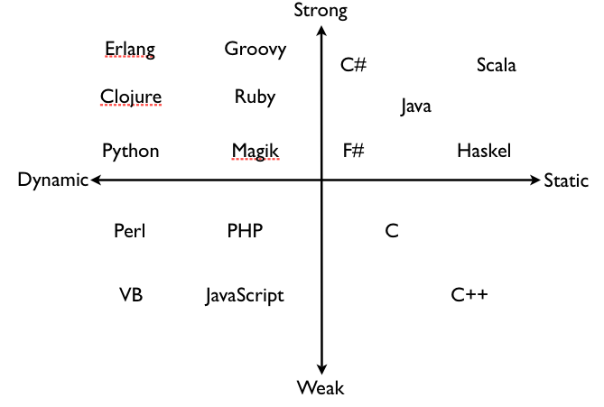
Typing Spectrum
Languages are often classified based on their approach to typing…

Slide 23
Defining Typing Terms...
“There is widespread confusion or disagreement about the meanings of the words
static, dynamic, strong and weak
when used to describe the type systems of programming languages”
https://pythonconquerstheuniverse.wordpress.com/2009/10/03/static-vs-dynamic-typing-of-programming-languages/

Slide 24
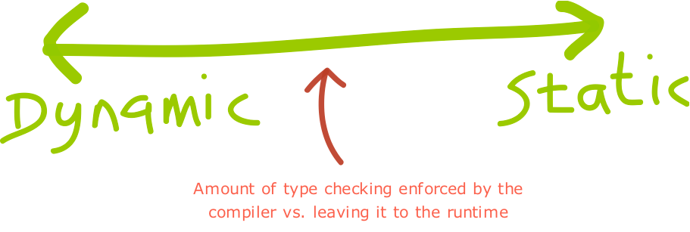

Slide 26
Dynamic Typing
“Variables’ type declarations
are not mandatory
and they will be
generated/inferred on the fly,
by their first use.”
http://blogs.agilefaqs.com/2011/07/11/dynamic-typing-is-not-weak-typing/

Slide 27
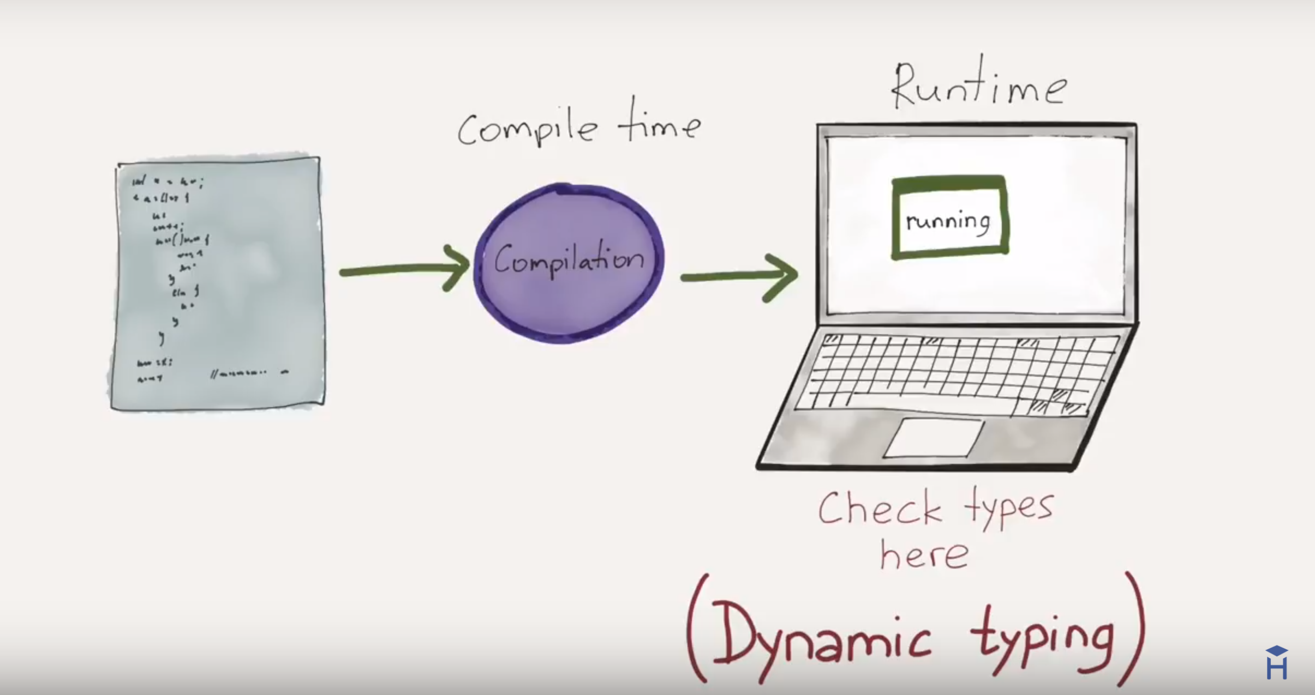
https://www.youtube.com/watch?v=C5fr0LZLMAs

Slide 28
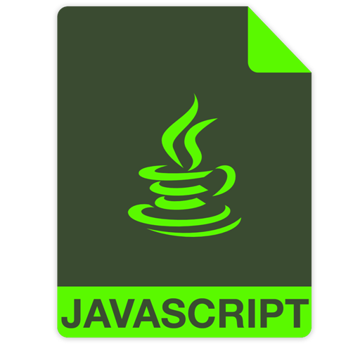
Dynamic Typing – Example
var greeting = ; //undefined
var someRandomInteger = 100;
var aDoubleVariable = 2.2;
greeting = "Hello!";
The JavaScript engine will choose a type that it feels best describes the data that’s contained inside of your variable → assign datatype behind the scenes.
A type is NOT assigned to the variables.
https://howtoprogramwithjava.com/dynamic-typing-vs-static-typing/

Slide 29
Static Typing
“Variable declarations are mandatory
before usage, else
results in a compile-time error"
http://blogs.agilefaqs.com/2011/07/11/dynamic-typing-is-not-weak-typing/

Slide 30
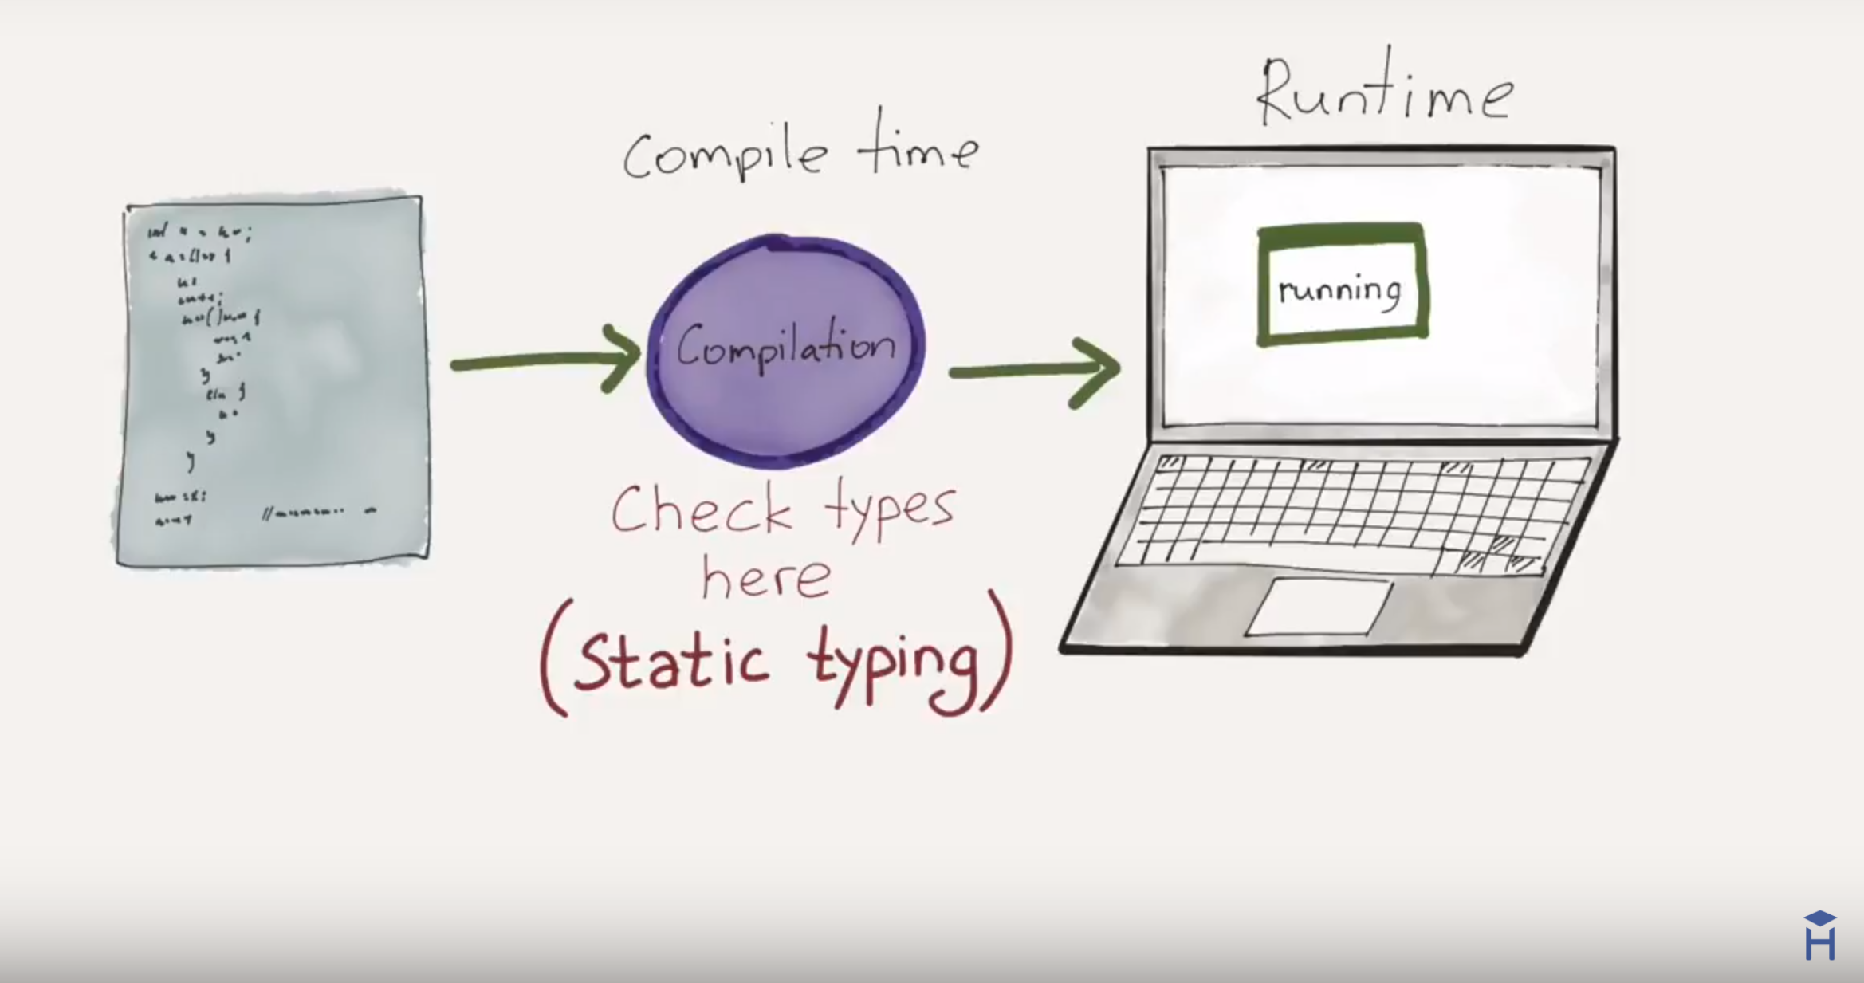
https://www.youtube.com/watch?v=C5fr0LZLMAs

Slide 31
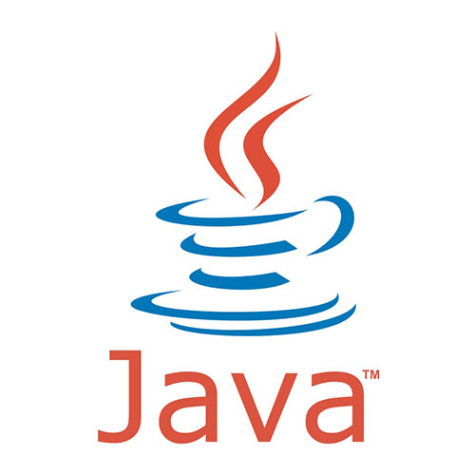
Static Typing – Example
String greeting = "Hello!";
int someRandomInteger = 100;
double aDoubleVariable = 2.2;
In Java, if we don’t assign a type, we get a compiler error → Java is statically typed.
Types determine the operations we can perform on the variables.
A type is assigned to each variable.
https://howtoprogramwithjava.com/dynamic-typing-vs-static-typing/

Slide 32
http://blogs.agilefaqs.com/2011/07/11/dynamic-typing-is-not-weak-typing/

Slide 33
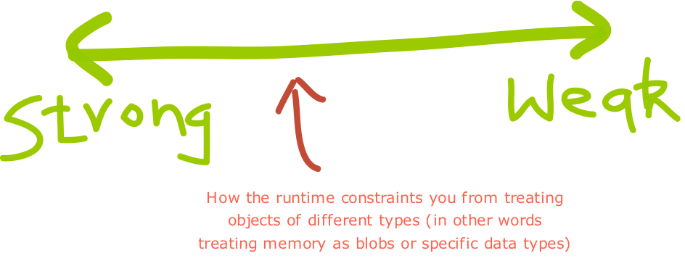

Slide 35
Strong Typing
“Once a variable is
declared as a specific data type,
it will be bound to that
particular data type.
You can explicitly cast the data type though.”
http://blogs.agilefaqs.com/2011/07/11/dynamic-typing-is-not-weak-typing/

Slide 36
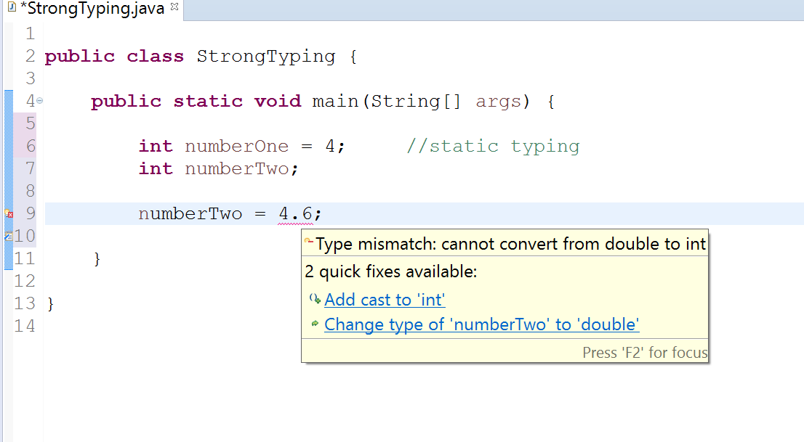
Strong Typing – Example 1

Slide 37
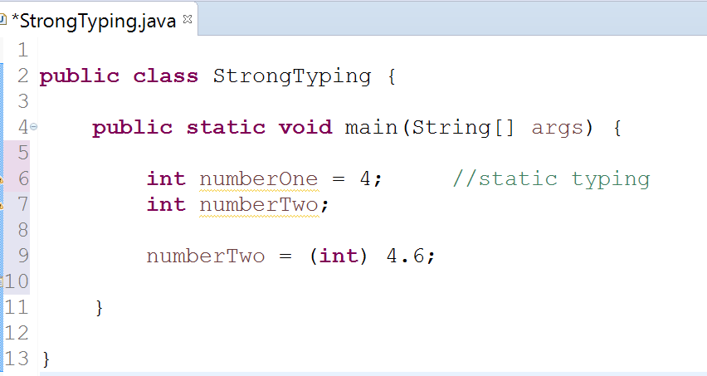
Strong Typing – Example 1 (fix with casting)
Casting resolves the type mismatch error

Slide 38
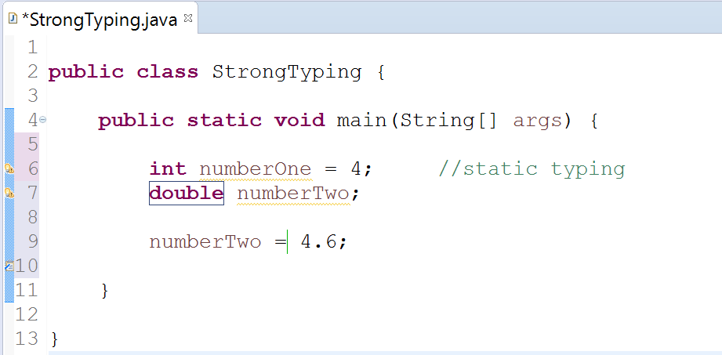
Strong Typing – Example 1 (fix with type)
Changing type to double from int.

Slide 39
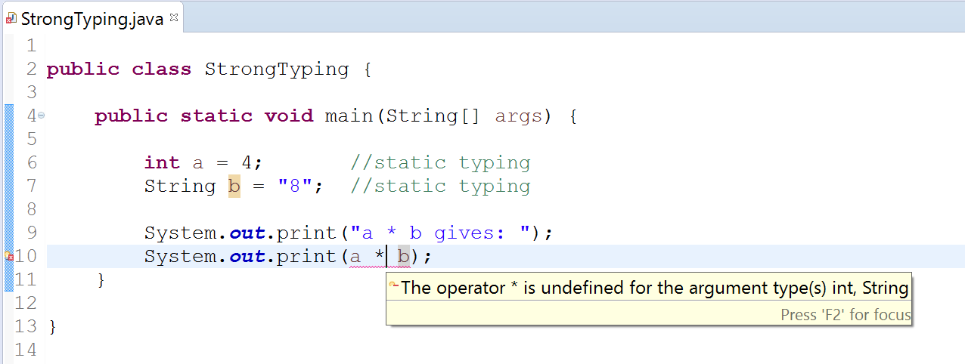
Strong Typing – Example 2

Slide 40
Weak Typing
“Variables are not of a specific data type.
However it doesn’t mean that variables are not “bound” to a specific data type.
In weakly typed languages, once a block of memory is associated with an object it can be reinterpreted as a different type of object.”
http://blogs.agilefaqs.com/2011/07/11/dynamic-typing-is-not-weak-typing/

Slide 41
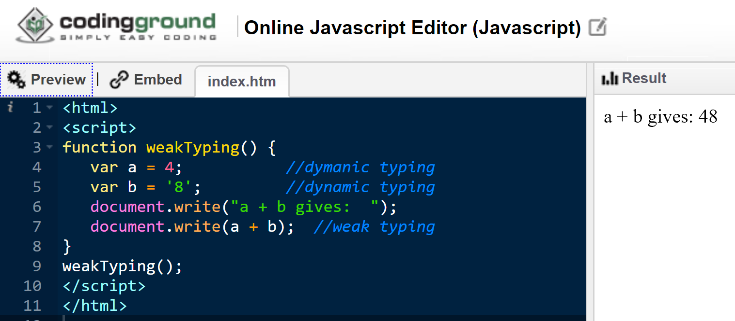
Weak Typing – Example 1
Notes:
<html><script>function weakTyping() { var a = 4; //static typing var b = '8'; //static typing document.write("a + b gives: "); document.write(a + b); //weak typing}weakTyping();</script></html>

Slide 42
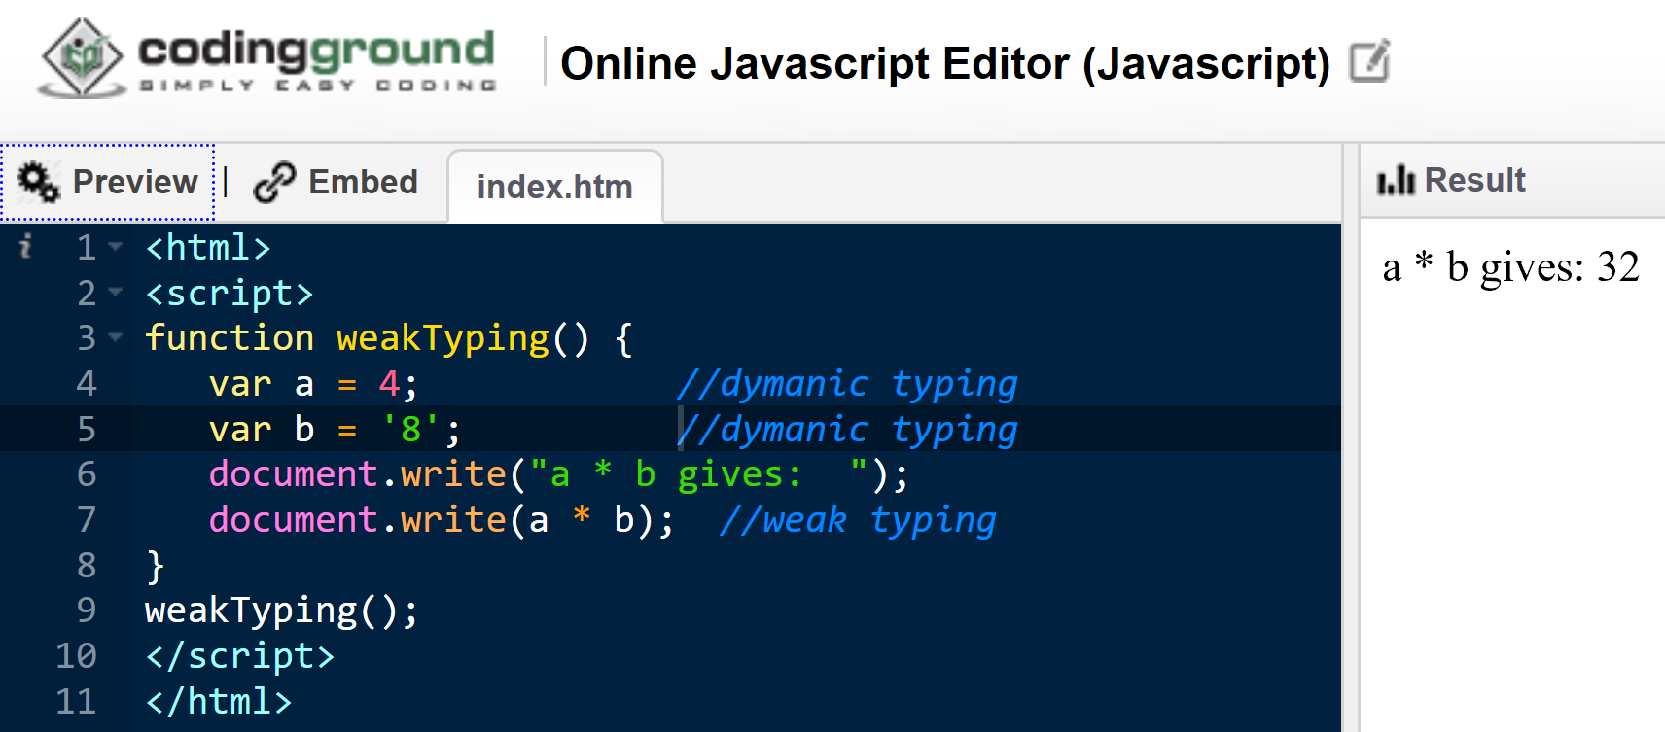
Weak Typing – Example 2

Slide 43
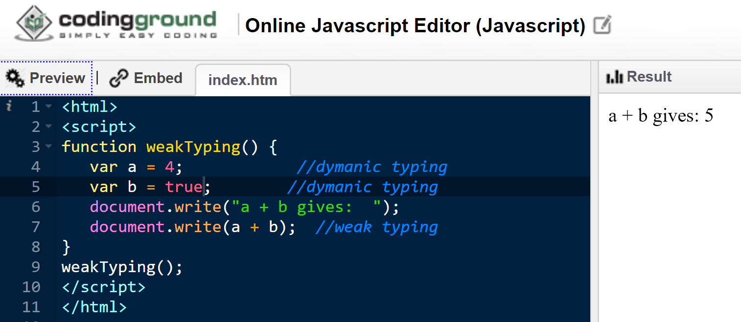
Weak Typing – Example 3

Slide 44
http://blogs.agilefaqs.com/2011/07/11/dynamic-typing-is-not-weak-typing/

Slide 45
Typing Spectrum
Continuum rather than an absolute measure; e.g. SmallTalk is more strongly typed compared to Python which is more strongly typed than JavaScript.
http://blogs.agilefaqs.com/2011/07/11/dynamic-typing-is-not-weak-typing/

